Slide 1
Microsoft Excel-The Basics

Slide 2
Basic Excel Orientation
Across the top are tabs
Tabs open ribbons
Ribbons contain groups
Some groups have a launch button-gives more options

Slide 3
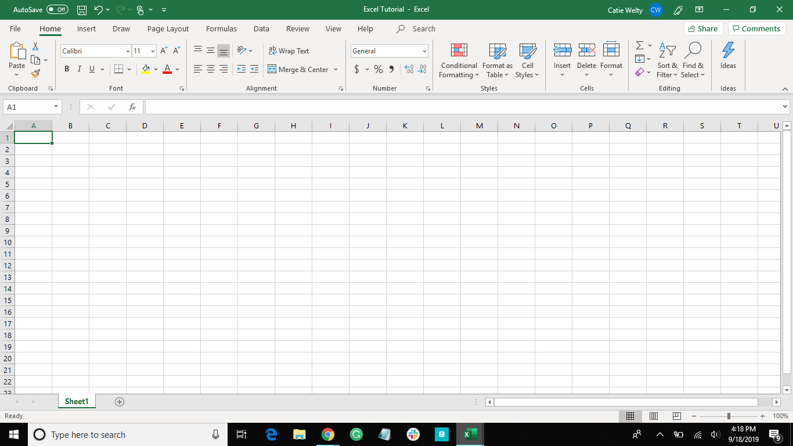
Tabs
Groups
Launch Button
Ribbon

Slide 4
Columns and rows
Infinite in number
Each cell has name
Named by column and row
Range-group of cells next to each that are together
Name a range by saying the upper left cell through the lower right cell
through= ‘:’
Sheets add up to form a workbook

Slide 5
Cell A1
Column
Row
Range of cells-
N5 through O10

Slide 6
How to Navigate through the Sheet
Enter = move down one
Shift+enter = move up one
Tab = move right one
Shift+tab = move left one
Clicking on the number of a row will select the whole row
Clicking on the letter of a column will select the whole column

Slide 7
Oops! I misspelled a word…….
There’s a difference between being on the cell and in the cell
You can edit the words of the cell only when you’re in the cell
Typing will replace what’s in the cell when you’re on the cell
Double click on a cell to enter into the cell

Slide 8
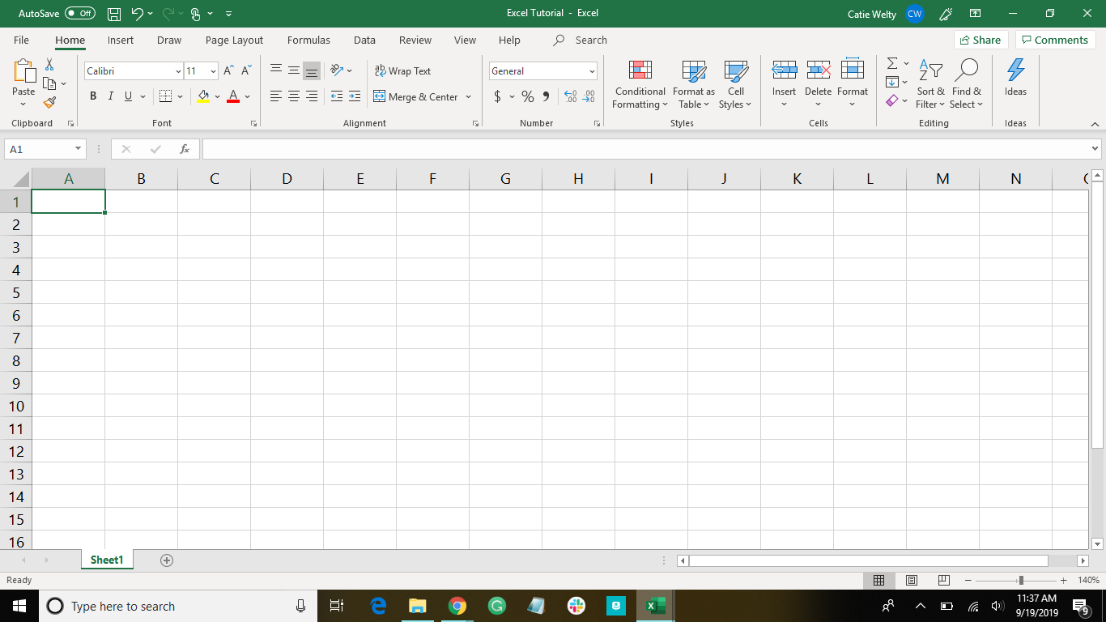
Here you are on the cell

Slide 9
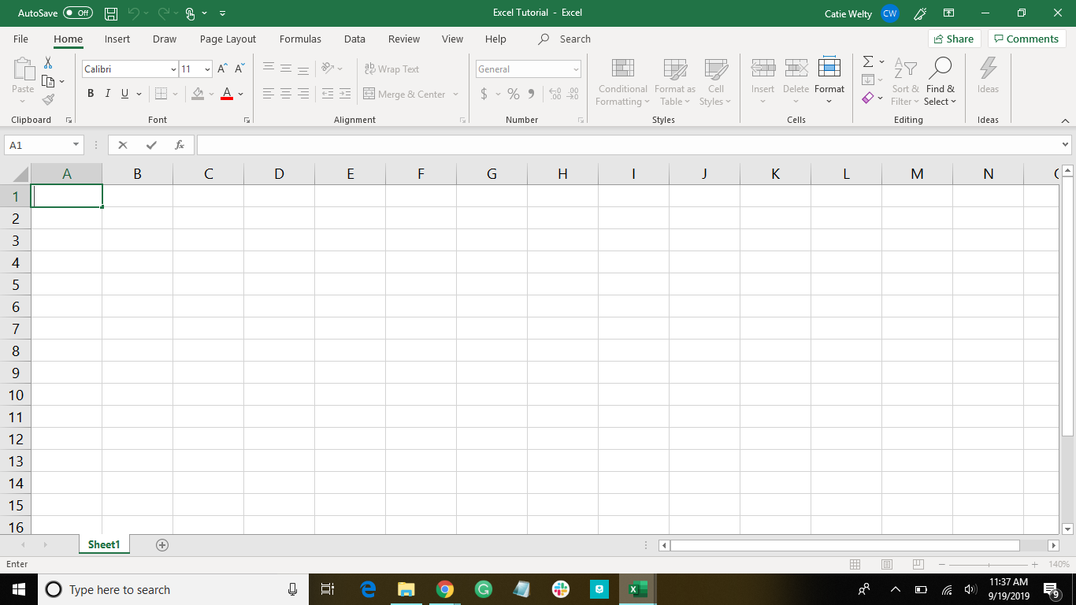
Here you are in the cell

Slide 10
Some Helpful Shortcuts
ctrl+I | italicize
ctrl+B | bold
ctrl+U | underline
ctrl+C | copy
ctrl+X | cut
ctrl+Z | undo
ctrl+V | paste
ctrl+F | find

Slide 11
Let’s get started making a spreadsheet!

Slide 12
Click on A1
Type in “Book Inventory”
Hit enter
Fill in the next line with the following categories:
Title
Author
Total Number of Pages

Slide 13
Notice- the words are bigger than the cell appears when you type “Book Inventory”
Let’s fix it!
Hover between the two column letters (the column the text is in and the next column)
Click and drag to stretch the column

Slide 14
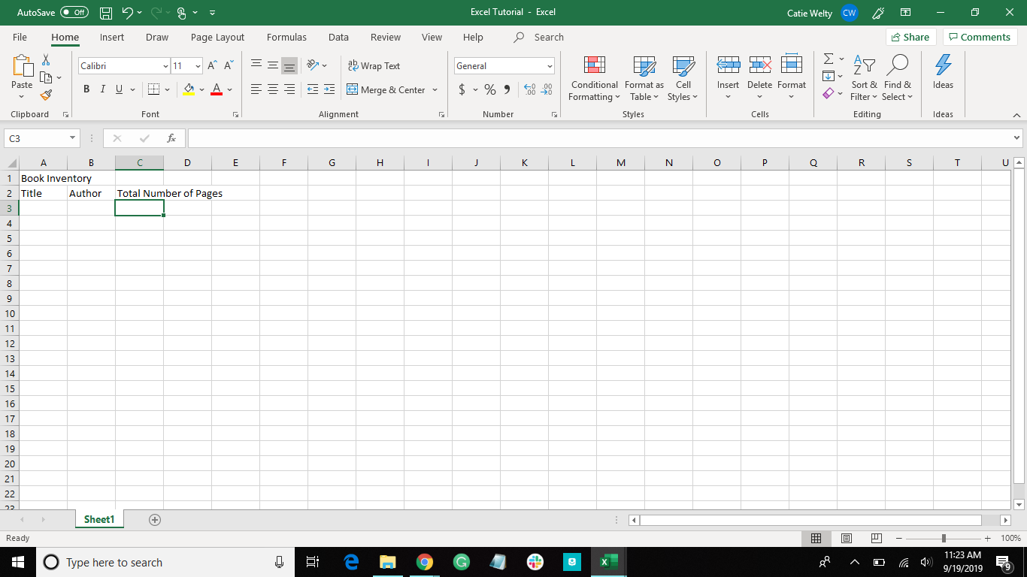
Hover here, then click and drag to make the column bigger

Slide 15
Let’s clean up the spreadsheet
Select the cells in the first row
Click on the Home Tab (up at the top)
Click on Merge & Center
Bold, Underline, Italicize as you prefer!

Slide 16
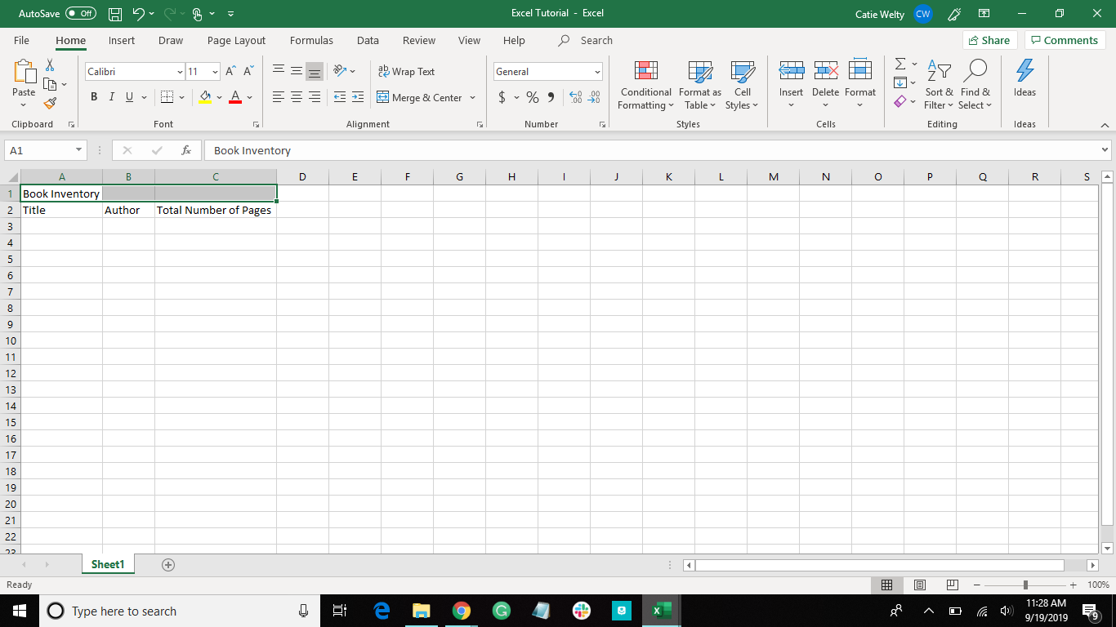
Select the cells in the first row
Click on the Home Tab (up at the top)
Click on Merge & Center

Slide 17




Here’s Some Data to Add
The Great Gatsby
By F. Scott Fitzgerald
218 pages
Catch-22
By Joseph Heller
453 pages
1984
By George Orwell
328 pages
Midnight’s Children
By Salman Rushdie
446 pages

Slide 18
Analyze Data

Slide 19
How to Add Numbers
Select the cell you want the total to be in
Type =SUM(cell_name:cell_name) ***Tip: after you typed the first cell, you can click on the next one instead of typing it***
Press enter
***Let’s put the analysis off to the side***

Slide 20
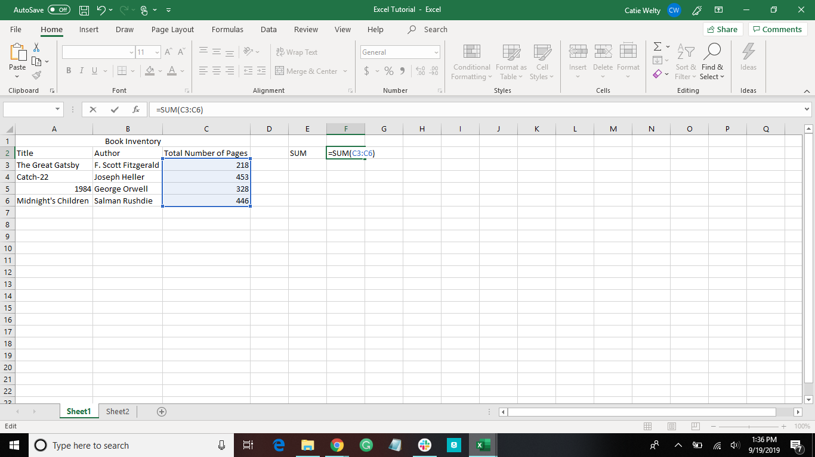

Slide 21
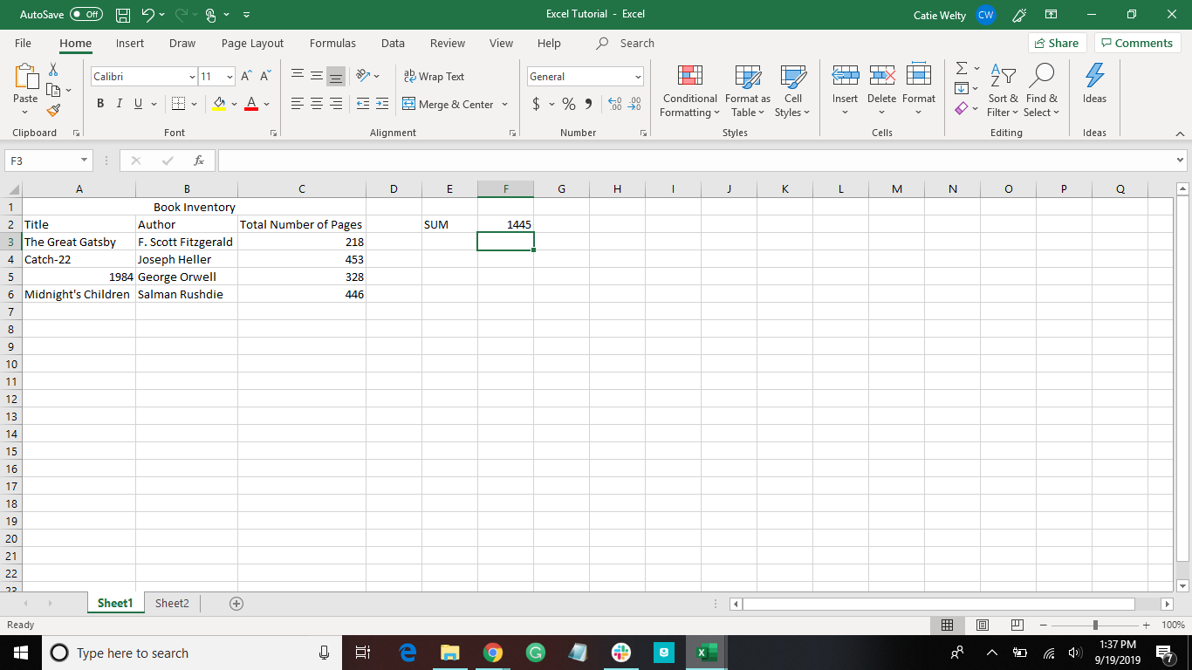

Slide 22
Another Way to Add Numbers
Select the cell you want the total to be in
Press alt and = simultaneously
Press enter

Slide 23
More About the SUM Function
=SUM(D38:D41)
Means “sum the values in cell D38 through cell D41 (cells D38, D39, D40, and D41)”
=SUM(D48,G48:G51,100)
Means “sum the value in D48, the values in cell G48 through cell G51, and 100”

Slide 24
Add Numbers Over a Certain Number
Select the cell you want the total to be in
Type =SUMIF(cell_name:cell_name, “>50”)
Press enter

Slide 25
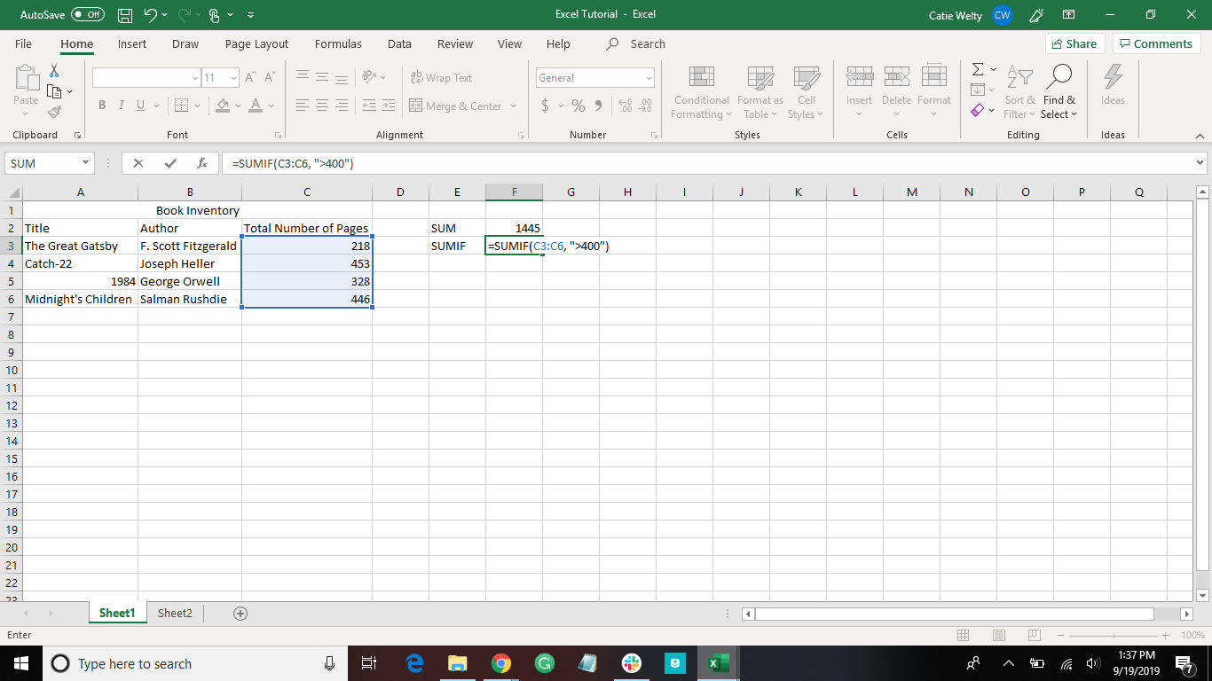

Slide 26
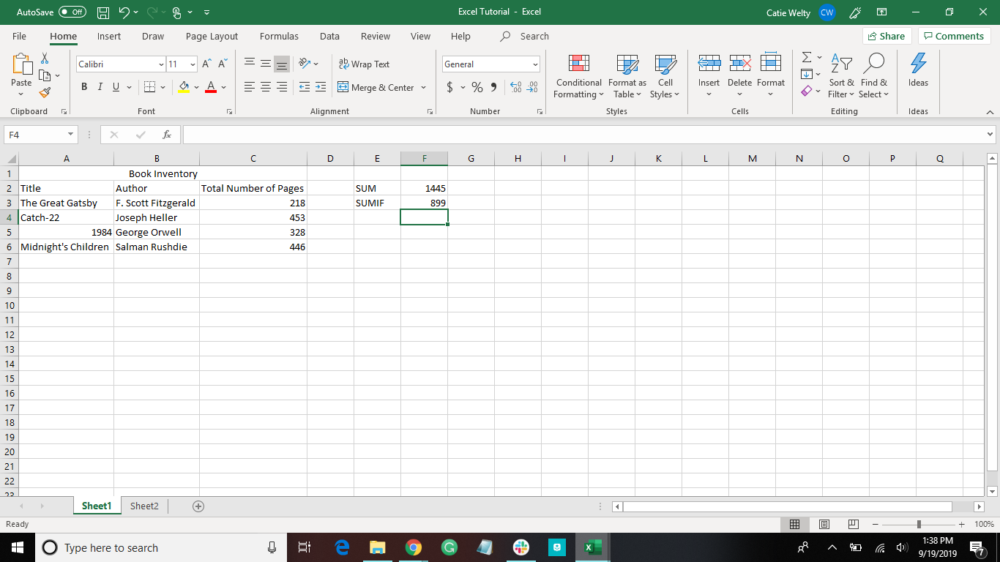

Slide 27
More About the SUMIF Function
=SUMIF(D73:D77,”>50”)
Means “look through cells D73 to D77, and if the value in the cell is greater than 50, sum it”

Slide 28
Math Functions
Adding cells is the only one with a specific function
Subtract | =cell_name-cell_name
Multiply | =cell_name*cell_name
Divide | =cell_name/cell_name

Slide 29
More Useful Functions
AVERAGE | =AVERAGE(cell_name,cell_name,cell_name,...)
IF | =IF(logical_test, [value_if_true], [value_if_false])
COUNT | =COUNT(cell_name:cell_name)
MAX | =MAX(cell_name:cell_name)
MIN | =MIN(cell_name:cell_name)

Slide 30
AVERAGE Function
Select the cell you want the total to be in
Type =AVERAGE(cell_name,cell_name,cell_name,...) or =AVERAGE(cell_name:cell_name)
Press enter
Used to find the average of a range of cells

Slide 31


Slide 32
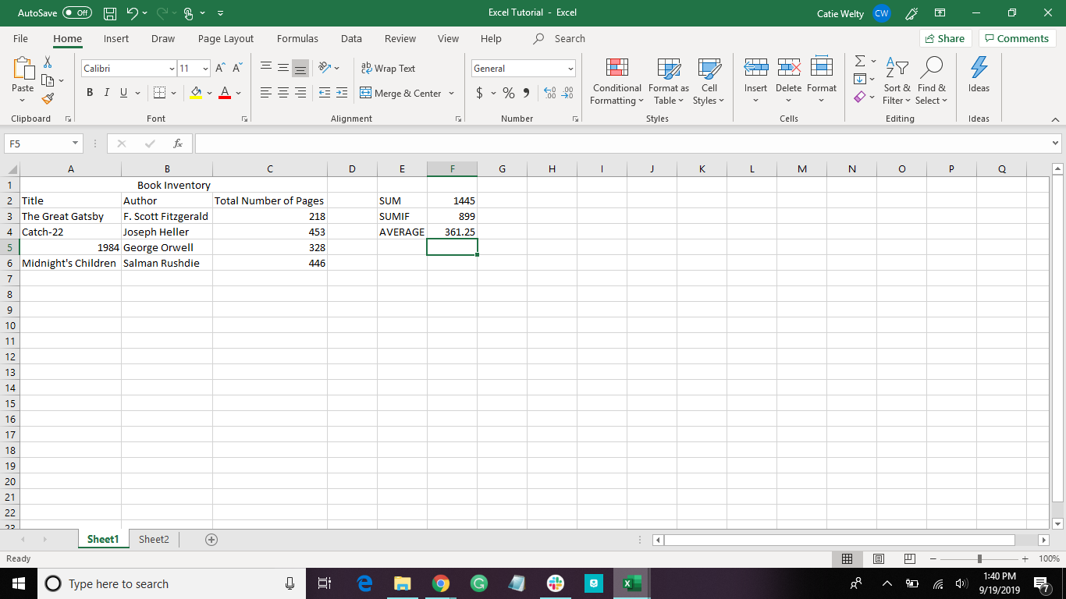

Slide 33
IF Function
Select the cell you want the total to be in
Type =IF(logical_test, [value_if_true], [values_if_false])
Press enter
Example: =IF(C3<C4, “TRUE”, “FALSE”)
Used to test relationships between two cells or to check if a cell has a certain number in it

Slide 34
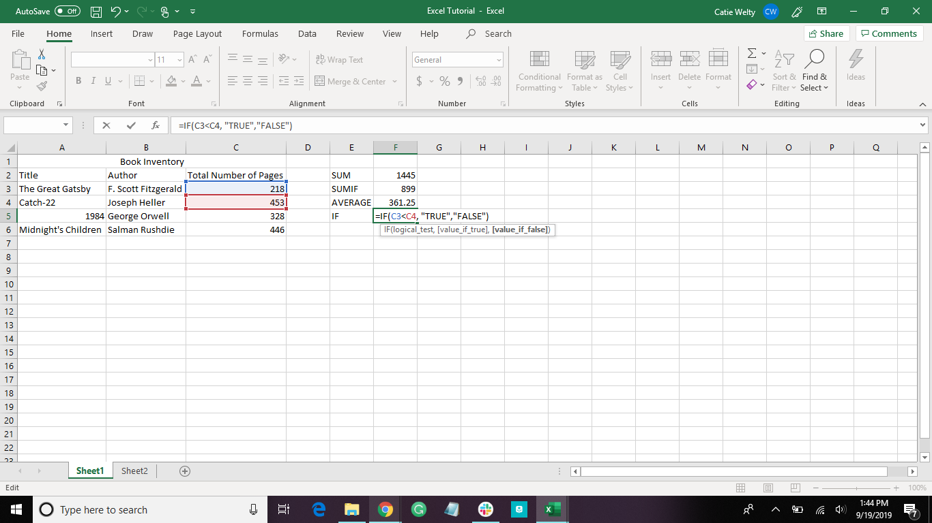

Slide 35


Slide 36
COUNT Function
Select the cell you want the total to be in
Type =COUNT(cell_name:cell_name)
Press enter
Used to count how many data points are in a range of cells
Only works for numerical data points

Slide 37
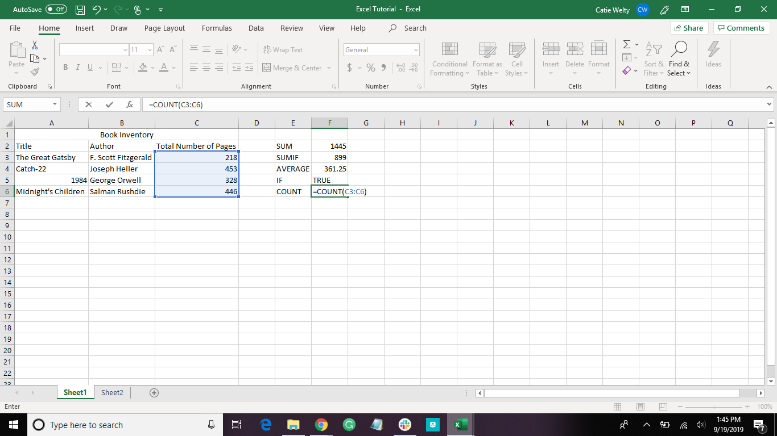

Slide 38
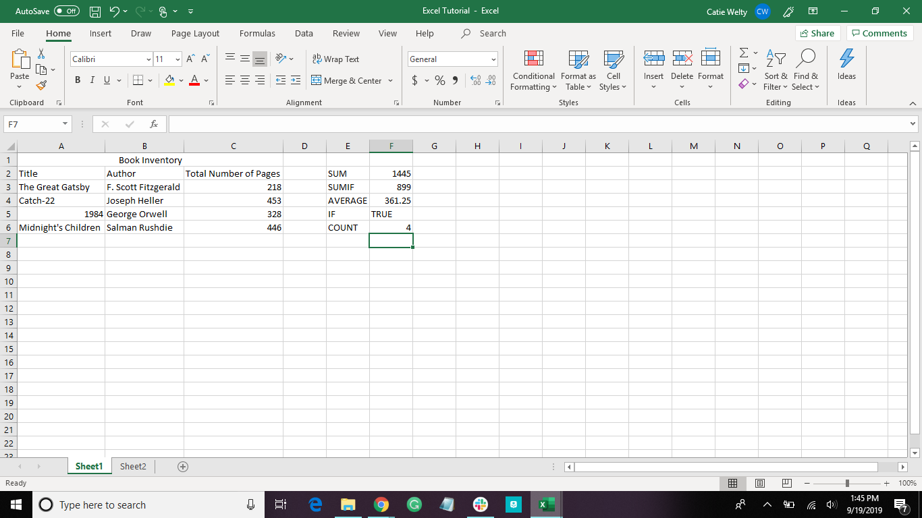

Slide 39
MAX Function
Select the cell you want the total to be in
Type =MAX(cell_name:cell_name)
Press enter
Used to find the largest number in a range of cells

Slide 40
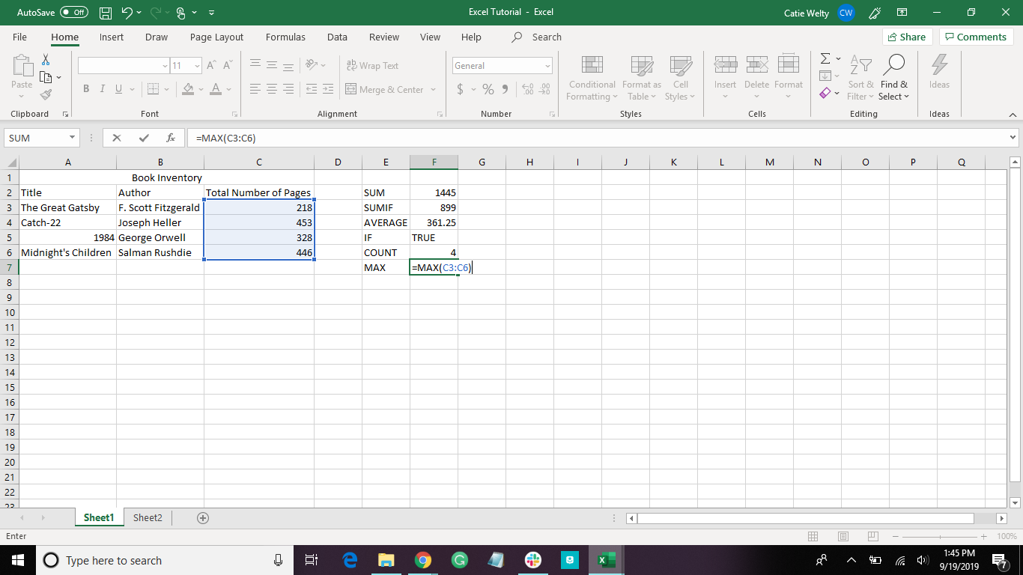

Slide 41


Slide 42
MIN Function
Select the cell you want the total to be in
Type =MIN(cell_name:cell_name)
Press enter
Used to find the smallest number in a range of cells

Slide 43
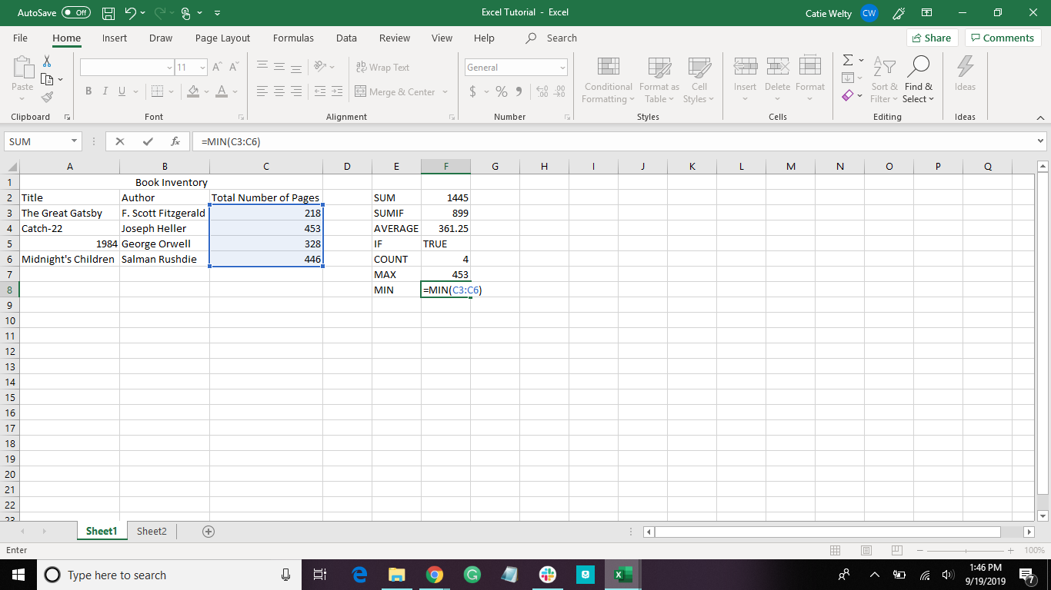

Slide 44


Slide 45
Fill In Cells Automatically
Fill down:
Rest cursor on the lower-right corner of the cell until it become a cross
Click the cross and drag down the cells you want it to fill
Fill right:
Rest cursor on the lower-right corner of the cell until it become a cross
Click the cross and drag across the cells you want it to fill

Slide 46



Here’s Some More Data
A Dark Inheritance
By Chris d’Lacy
304 pages
Alexander’s Army
By Chris d’Lacy
304 pages
A Crown of Dragons
By Chris d’Lacy
352 pages

Slide 47
Notice:
All three have the same author
Let’s use automatic filling to input the author for these books

Slide 48
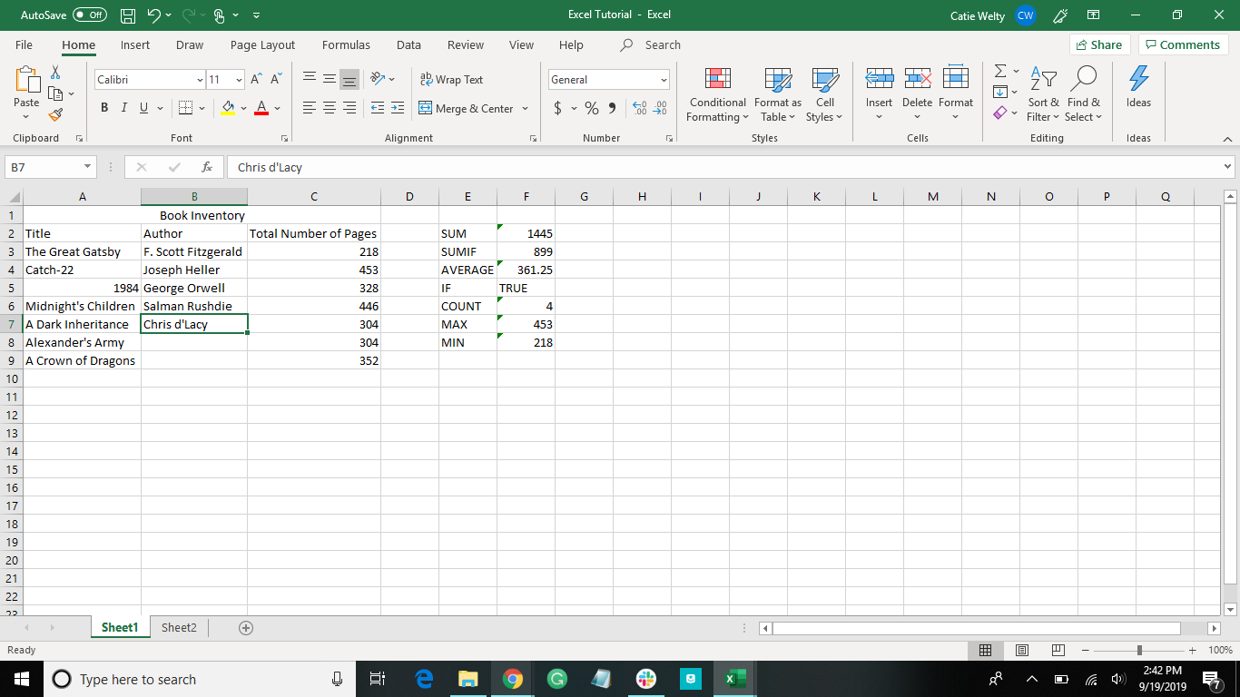
Click and drag down

Slide 49
What can filling cells automatically be used for?
This can be used for many things:
Filling in patterns
Numbers, or letters
Excel will automatically detect specific patterns, such as:
Months
Dates
Number patterns
For a number pattern, see next slide
Filling in cells with the same word

Slide 50
Fill Cells Automatically with a Pattern
Fill at least two cells in the pattern
Select full pattern
Rest cursor on the lower-right corner of the cell until it become a cross
Click the cross and drag across the cells you want it to fill

Slide 51
To practice with automatically filling a pattern, let’s number the books in our inventory
In order to do this, we need to add a column in the front

Slide 52
How to Add a Column
Click on the column letter to select the whole column
Right-click, and select insert

Slide 53
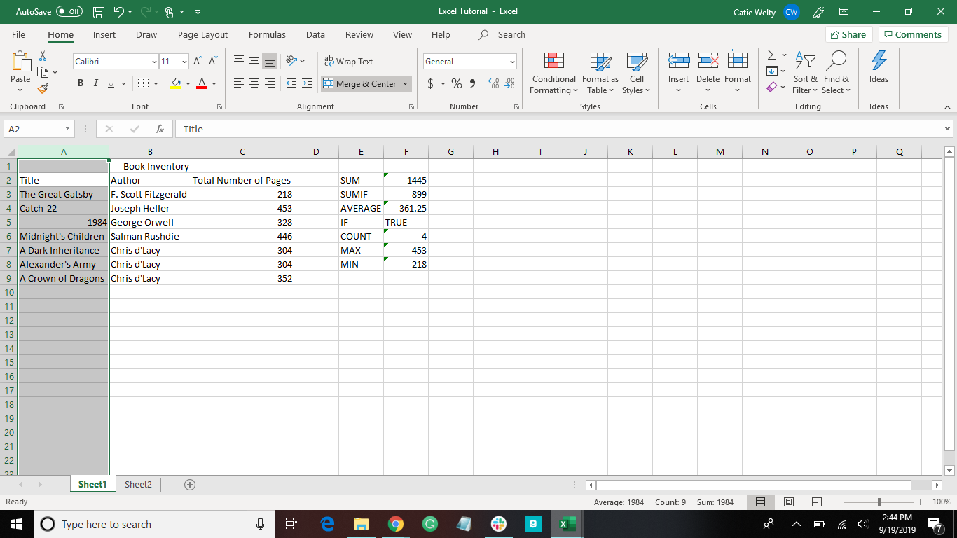

Slide 54
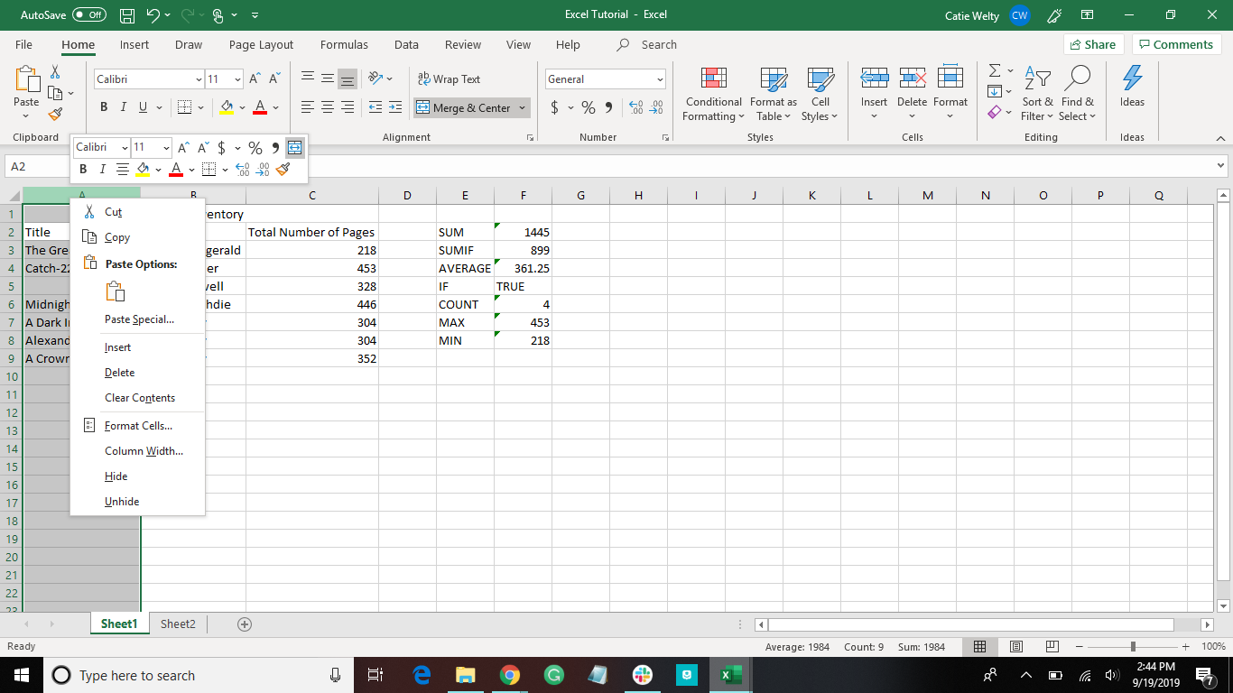

Slide 55
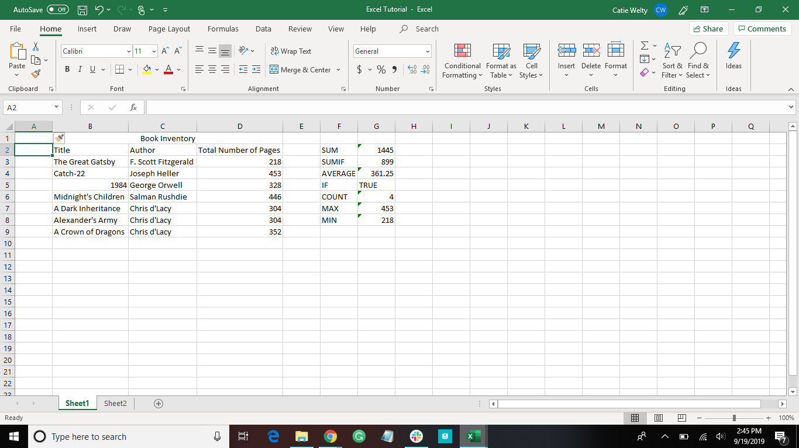

Slide 56
Now we can number the books:
All we have to do is number the first two, and excel can fill in rest!

Slide 57
Fill Cells Automatically with a Pattern
Fill at least two cells in the pattern
Select full pattern
Rest cursor on the lower-right corner of the cell until it become a cross
Click the cross and drag across the cells you want it to fill

Slide 58

Click and drag down

Slide 59
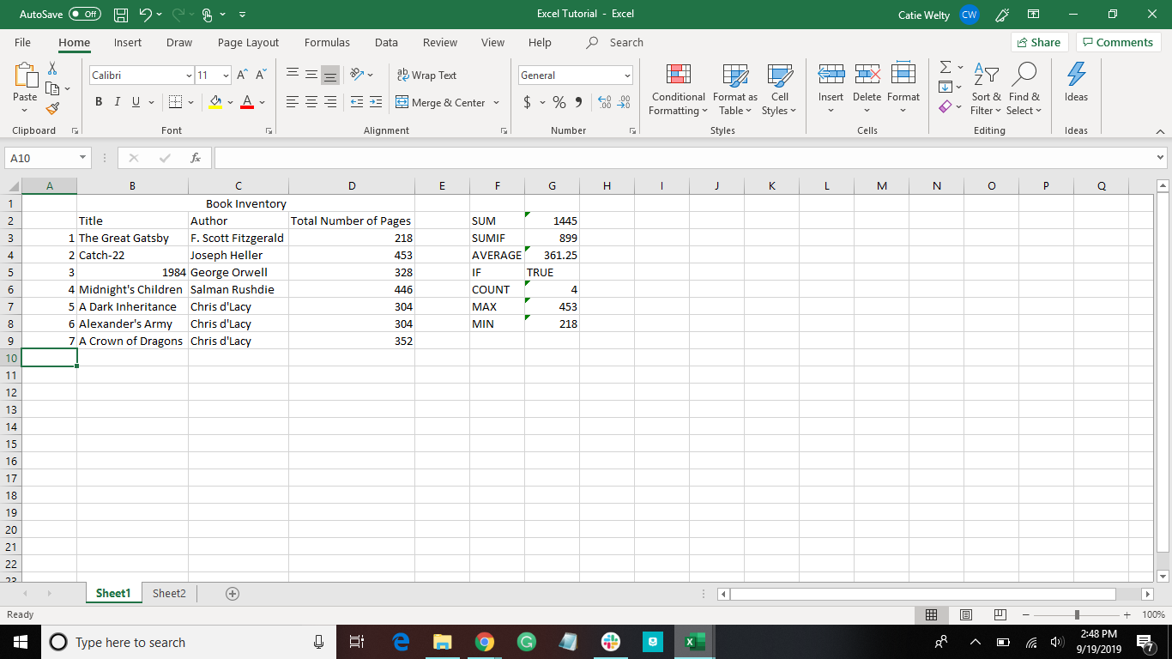

Slide 60
Represent Data

Slide 61
Let’s create a new sheet for some data
Click Here

Slide 62
How to Make a Table
ctrl+T | Create table
Type in the pop-up the range of cells for the table
Let’s make a 2 by 10 table

Slide 63
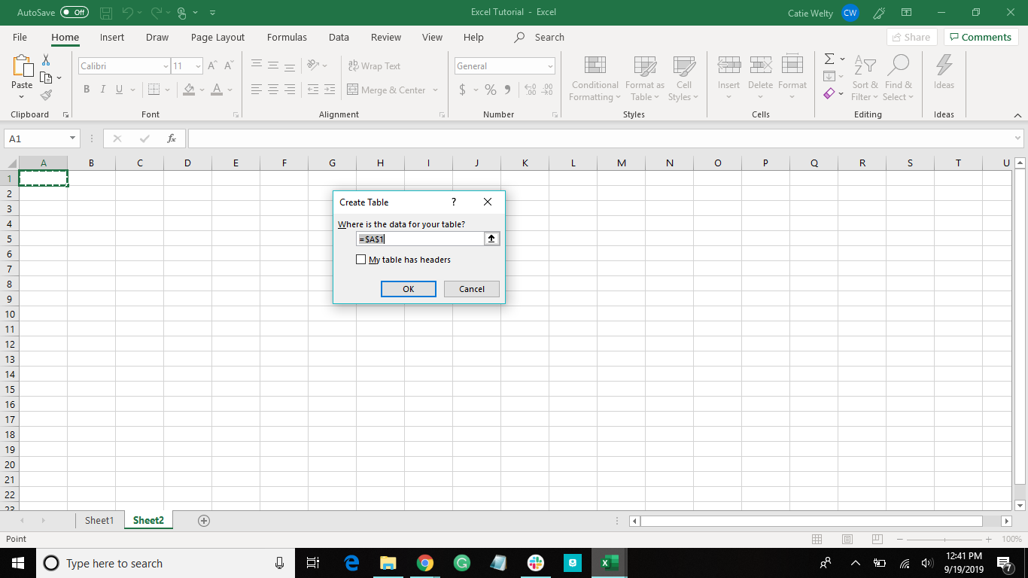

Slide 64
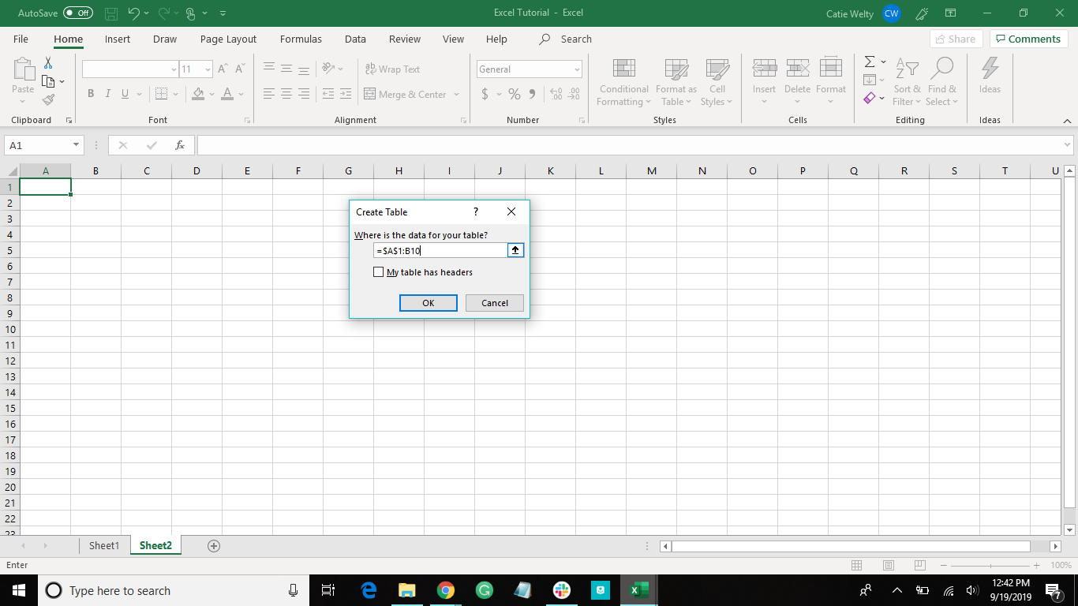

Slide 65
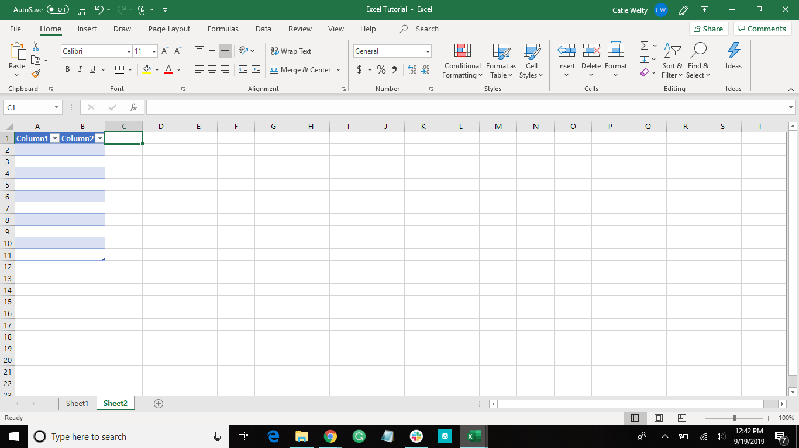

Slide 66
FIll Cells Automatically in a Table
Rest cursor on the lower-right corner of the cell until it become a cross
Double click on the cross
If you want a pattern in the cells:
Fill in at least two cells in the pattern
Select those cells
Follow steps above

Slide 67
Let’s use this to make a table of the following coordinates:
(1,1), (2,2), (3,3)... (10,10)
***you can fill the cells automatically, as we learned earlier***

Slide 68
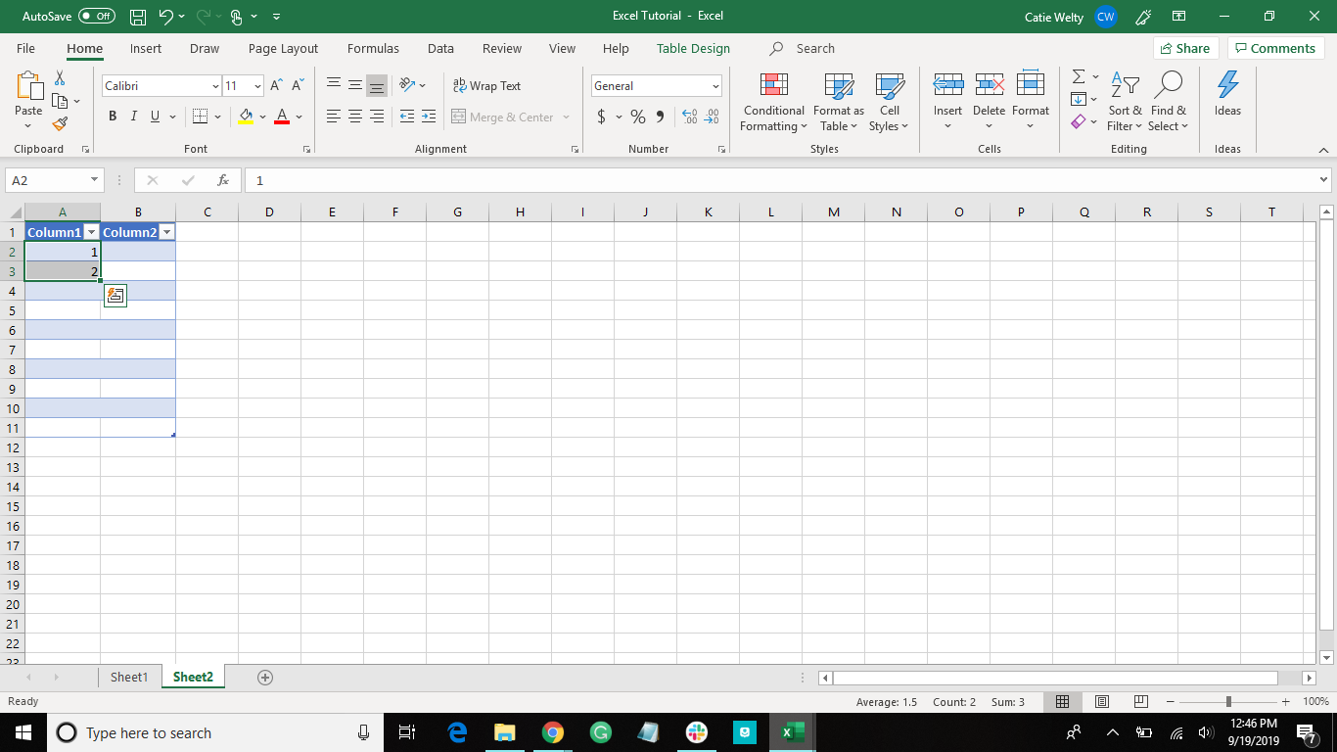
Repeat for Column 2
Double click

Slide 69
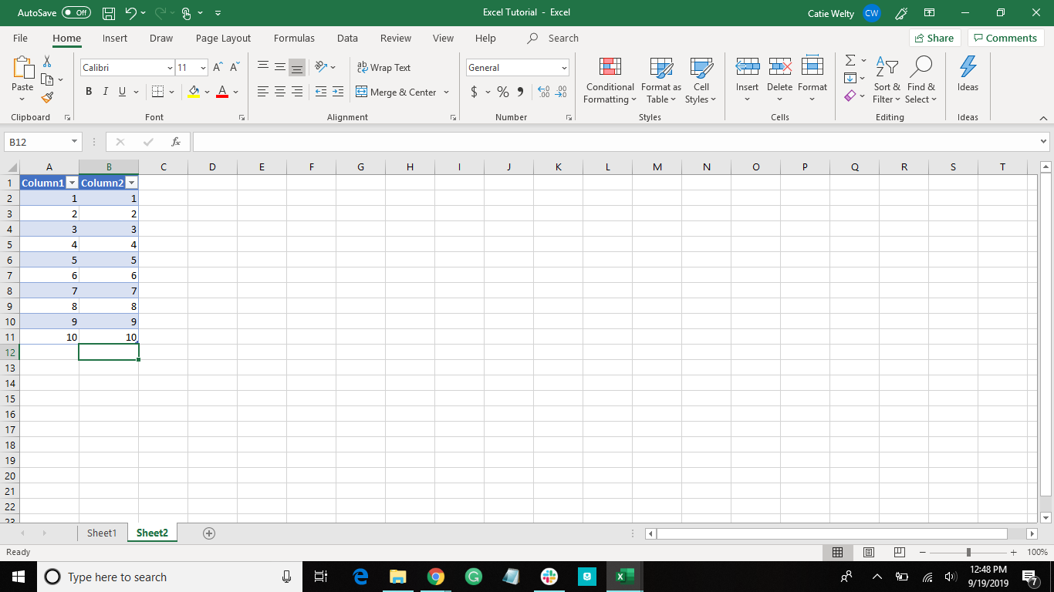

Slide 70
How to Make Charts
Insert data into the workbook
Select the data
Click on “Insert”
Click on the type of chart you want
Recommended chooses what Excel thinks is the best fit for the data
You can always choose which one you want

Slide 71
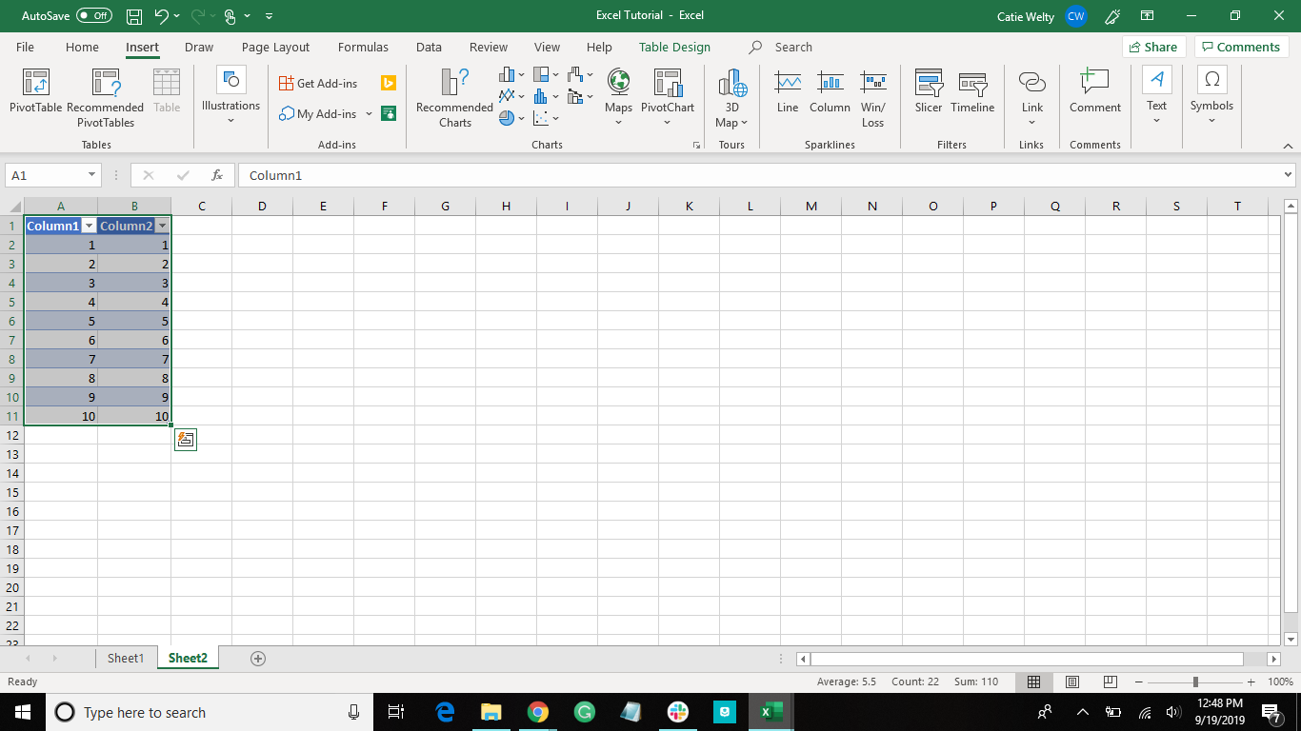
Click here to have Excel choose a chart...
...or choose the one you want from here

Slide 72
How to Make Charts Shortcut
ctrl+Q | Create chart
This only works when the data is in a table
Choose what kind of chart fits with the data, or let Excel decide
***have to be on a cell within the table for this shortcut to work***

Slide 73
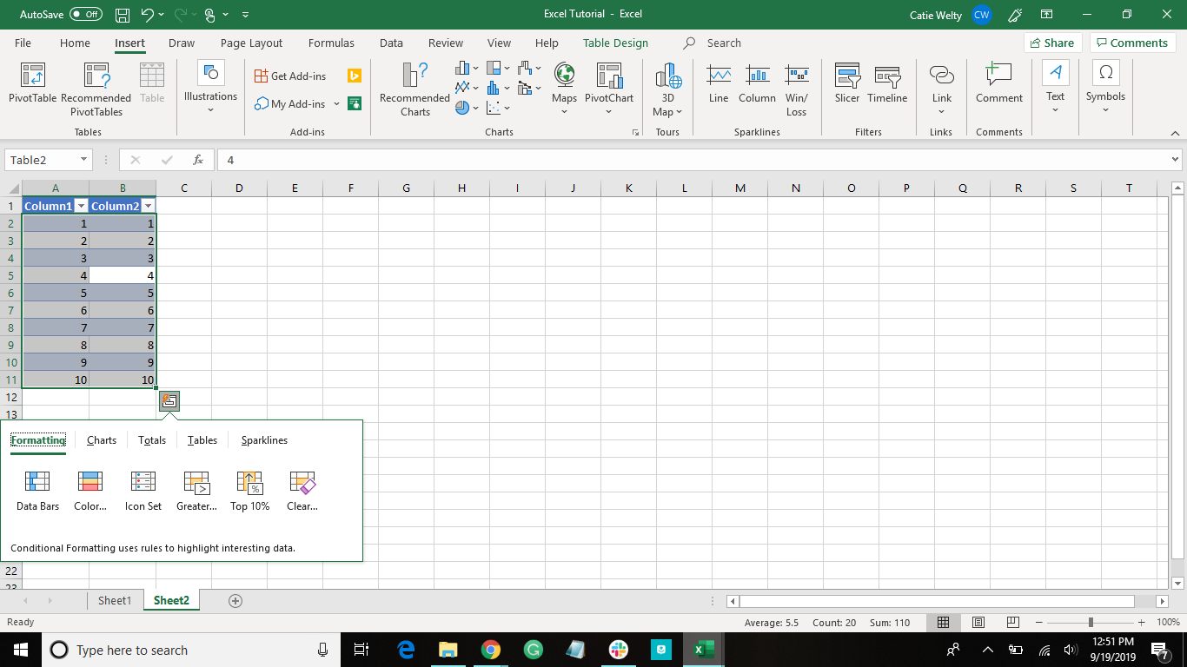
Click here to choose the chart type

Slide 74
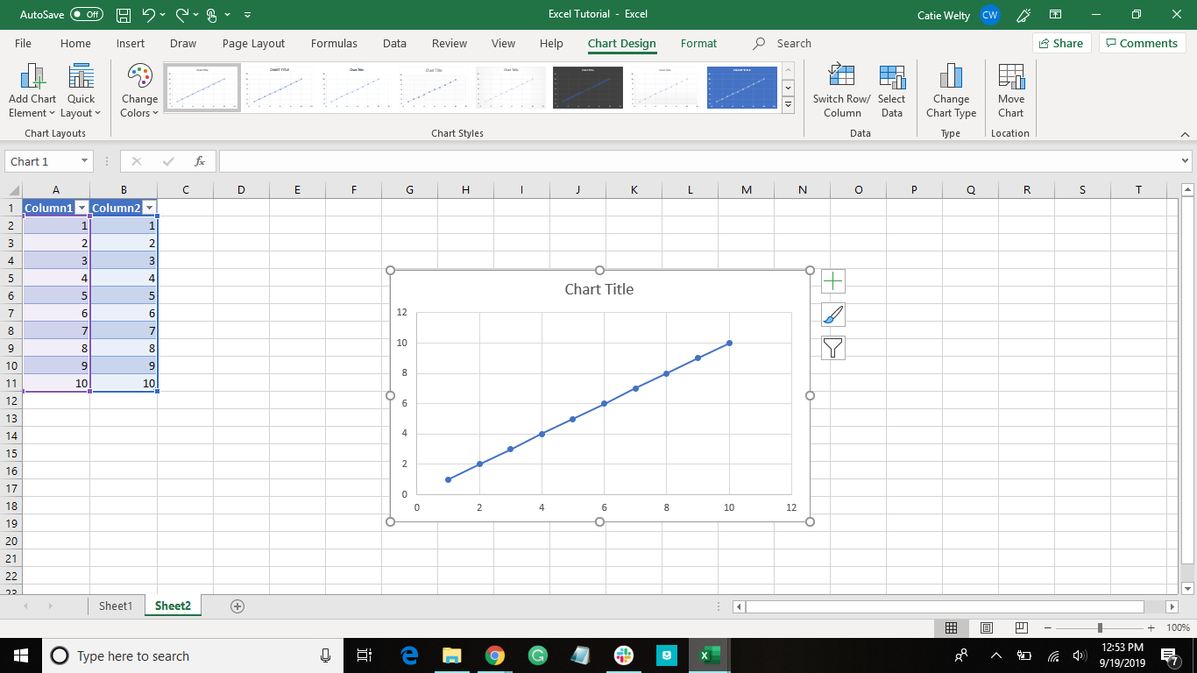
Use these to personalize your chart

Slide 75


Slide 76
New Shortcuts
ctrl+T | Create table
ctrl+Q | Create chart | Data has to be in a table

Slide 77
Shortcuts
ctrl+I | italicize
ctrl+B | bold
ctrl+U | underline
ctrl+C | copy
ctrl+X | cut
ctrl+Z | undo
ctrl+V | paste
ctrl+F | find
ctrl+T | Create table
ctrl+Q | Create chart | Data has to be in a table

Slide 78
Functions
SUM | =SUM(cell_name:cell_name)
SUMIF | =SUMIF(cell_name:cell_name, “>50”)
AVERAGE | =AVERAGE(cell_name,cell_name,cell_name,...)
IF | =IF(logical_test, [value_if_true], [value_if_false])
COUNT | =COUNT(cell_name:cell_name)
MAX | =MAX(cell_name:cell_name)
MIN | =MIN(cell_name:cell_name)

Slide 79
Have more questions?
Assignment
Submit the Excel Sheet you created during this presentation.
Email us at ccla@doane.edu or come visit us in Communications 188D from 9am to 5pm.
You can also visit our website at https://www.doane.edu/ccla

Slide 80
References
[Technology for Teachers and Students]. (2017, April 24). The Beginner’s Guide to Excel-Excel Basics Tutorial. [Video file]. Retrieved from https://www.youtube.com/watch?v=rwbho0CgEAE
Microsoft Excel. Excel Help. n.d.
Basic Excel Formulas - List of Important Formulas for Beginners. (n.d.). Retrieved from https://corporatefinanceinstitute.com/resources/excel/study/basic-excel-formulas-beginners/

Slide 81

Please provide some feedback on the presentation by following the QR Code below.

